Slide 1
Chapter 4
The Von Neumann Model

Slide 2
The Stored Program Computer
1943: ENIAC
  Presper Eckert and John Mauchly -- first general electronic computer.
  (or was it John V. Atanasoff in 1939?)
  Hard-wired program -- settings of dials and switches.
1944: Beginnings of EDVAC
  among other improvements, includes program stored in memory
1945: John von Neumann
  wrote a report on the stored program concept,
  known as the First Draft of a Report on EDVAC
The basic structure proposed in the draft became known
as the “von Neumann machine” (or model).
  a memory, containing instructions and data
  a processing unit, for performing arithmetic and logical operations
  a control unit, for interpreting instructions
For more history, see http://www.maxmon.com/history.htm

Slide 3
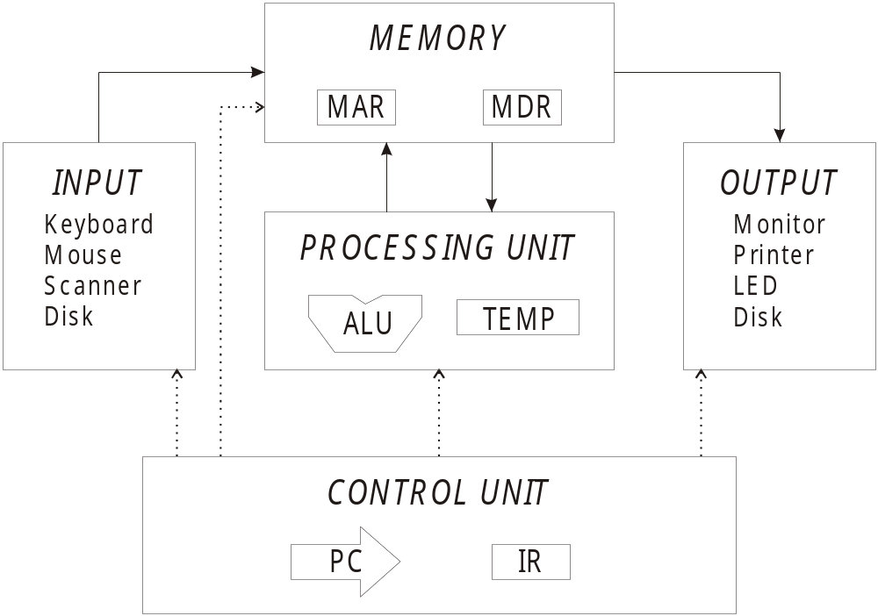
Von Neumann Model

Slide 4
Memory
2^{k} x m array of stored bits
Address
  unique (k-bit) identifier of location
Contents
  m-bit value stored in location
Basic Operations:
LOAD
  read a value from a memory location
STORE
  write a value to a memory location
0000
0001
0010
0011
0100
0101
0110
1101
1110
1111
00101101
•
•
•
10100010

Slide 5

Interface to Memory
How does processing unit get data to/from memory?
MAR: Memory Address Register
MDR: Memory Data Register
To LOAD a location (A):
  Write the address (A) into the MAR.
  Send a “read” signal to the memory.
  Read the data from MDR.
To STORE a value (X) to a location (A):
  Write the data (X) to the MDR.
  Write the address (A) into the MAR.
  Send a “write” signal to the memory.

Slide 6
Interface to Memory
How does processing unit get data to/from memory?
MAR: Memory Address Register
MDR: Memory Data Register
To LOAD a location (A):
  Write the address (A) into the MAR.
  Send a “read” signal to the memory.
  Read the data from MDR.
To STORE a value (X) to a location (A):
  Write the data (X) to the MDR.
  Write the address (A) into the MAR.
  Send a “write” signal to the memory.

Slide 7
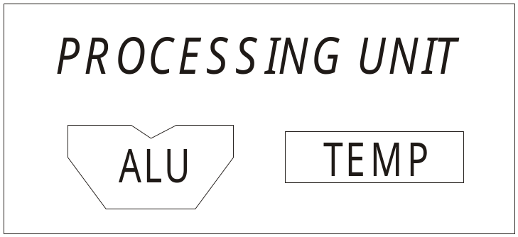
Processing Unit
Functional Units
  ALU = Arithmetic and Logic Unit
  could have many functional units.
  some of them special-purpose
  (multiply, square root, …)
  LC-3 performs ADD, AND, NOT
Registers
  Small, temporary storage
  Operands and results of functional units
  LC-3 has eight registers (R0, …, R7), each 16 bits wide
Word Size
  number of bits normally processed by ALU in one instruction
  also width of registers
  LC-3 is 16 bits

Slide 8
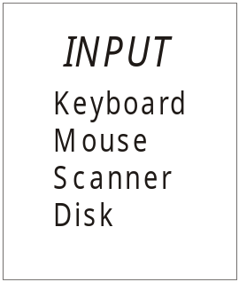
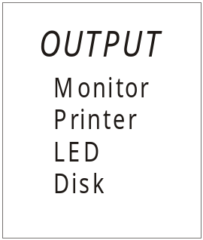
Input and Output
Devices for getting data into and out of computer memory
Each device has its own interface,
usually a set of registers like the
memory’s MAR and MDR
  LC-3 supports keyboard (input) and monitor (output)
  keyboard: data register (KBDR) and status register (KBSR)
  monitor: data register (DDR) and status register (DSR)
Some devices provide both input and output
  disk, network
Program that controls access to a device is
usually called a driver.

Slide 9

Control Unit
Orchestrates execution of the program
Instruction Register (IR) contains the current instruction.
Program Counter (PC) contains the address
of the next instruction to be executed.
Control unit:
  reads an instruction from memory
    the instruction’s address is in the PC
  interprets the instruction, generating signals
  that tell the other components what to do
    an instruction may take many machine cycles to complete

Slide 10
Instruction Processing
Fetch instruction from memory
Decode instruction
Evaluate address
Fetch operands from memory
Execute operation
Store result

Slide 11
Instruction
The instruction is the fundamental unit of work.
Specifies two things:
  opcode: operation to be performed
  operands: data/locations to be used for operation
An instruction is encoded as a sequence of bits.
(Just like data!)
  Often, but not always, instructions have a fixed length,
  such as 16 or 32 bits.
  Control unit interprets instruction:
  generates sequence of control signals to carry out operation.
  Operation is either executed completely, or not at all.
A computer’s instructions and their formats is known as its
Instruction Set Architecture (ISA).

Slide 12
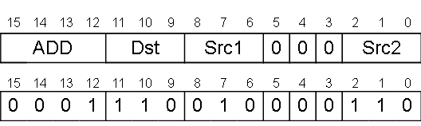
Example: LC-3 ADD Instruction
LC-3 has 16-bit instructions.
  Each instruction has a four-bit opcode, bits [15:12].
LC-3 has eight registers (R0-R7) for temporary storage.
  Sources and destination of ADD are registers.
“Add the contents of R2 to the contents of R6,
and store the result in R6.”

Slide 13
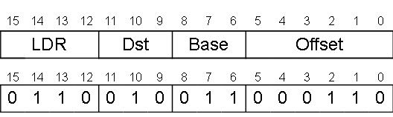
Example: LC-3 LDR Instruction
Load instruction -- reads data from memory
Base + offset mode:
  add offset to base register -- result is memory address
  load from memory address into destination register
“Add the value 6 to the contents of R3 to form a
memory address. Load the contents of that
memory location to R2.”

Slide 14
Instruction Processing: FETCH
Load next instruction (at address stored in PC)
from memory
into Instruction Register (IR).
  Copy contents of PC into MAR.
  Send “read” signal to memory.
  Copy contents of MDR into IR.
Then increment PC, so that it points to
the next instruction in sequence.
  PC becomes PC+1.
F
D
EA
OP
EX
S

Slide 15
Instruction Processing: DECODE
First identify the opcode.
  In LC-3, this is always the first four bits of instruction.
  A 4-to-16 decoder asserts a control line corresponding
  to the desired opcode.
Depending on opcode, identify other operands
from the remaining bits.
  Example:
    for LDR, last six bits is offset
    for ADD, last three bits is source operand #2
F
D
EA
OP
EX
S

Slide 16
Instruction Processing: EVALUATE ADDRESS
For instructions that require memory access,
compute address used for access.
Examples:
  add offset to base register (as in LDR)
  add offset to PC
  add offset to zero
F
D
EA
OP
EX
S

Slide 17
Instruction Processing: FETCH OPERANDS
Obtain source operands needed to
perform operation.
Examples:
  load data from memory (LDR)
  read data from register file (ADD)
F
D
EA
OP
EX
S

Slide 18
Instruction Processing: EXECUTE
Perform the operation,
using the source operands.
Examples:
  send operands to ALU and assert ADD signal
  do nothing (e.g., for loads and stores)
F
D
EA
OP
EX
S

Slide 19
Instruction Processing: STORE RESULT
Write results to destination.
(register or memory)
Examples:
  result of ADD is placed in destination register
  result of memory load is placed in destination register
  for store instruction, data is stored to memory
    write address to MAR, data to MDR
    assert WRITE signal to memory
F
D
EA
OP
EX
S

Slide 20
Changing the Sequence of Instructions
In the FETCH phase,
we increment the Program Counter by 1.
What if we don’t want to always execute the instruction
that follows this one?
  examples: loop, if-then, function call
Need special instructions that change the contents
of the PC.
These are called control instructions.
  jumps are unconditional -- they always change the PC
  branches are conditional -- they change the PC only if
  some condition is true (e.g., the result of an ADD is zero)

Slide 21
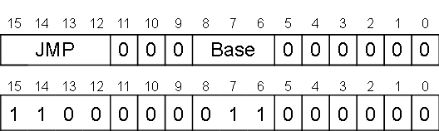
Example: LC-3 JMP Instruction
Set the PC to the value contained in a register. This becomes the address of the next instruction to fetch.
“Load the contents of R3 into the PC.”

Slide 22
Instruction Processing Summary
Instructions look just like data -- it’s all interpretation.
Three basic kinds of instructions:
  computational instructions (ADD, AND, …)
  data movement instructions (LD, ST, …)
  control instructions (JMP, BRnz, …)
Six basic phases of instruction processing:
F → D → EA → OP → EX → S
  not all phases are needed by every instruction
  phases may take variable number of machine cycles

Slide 23
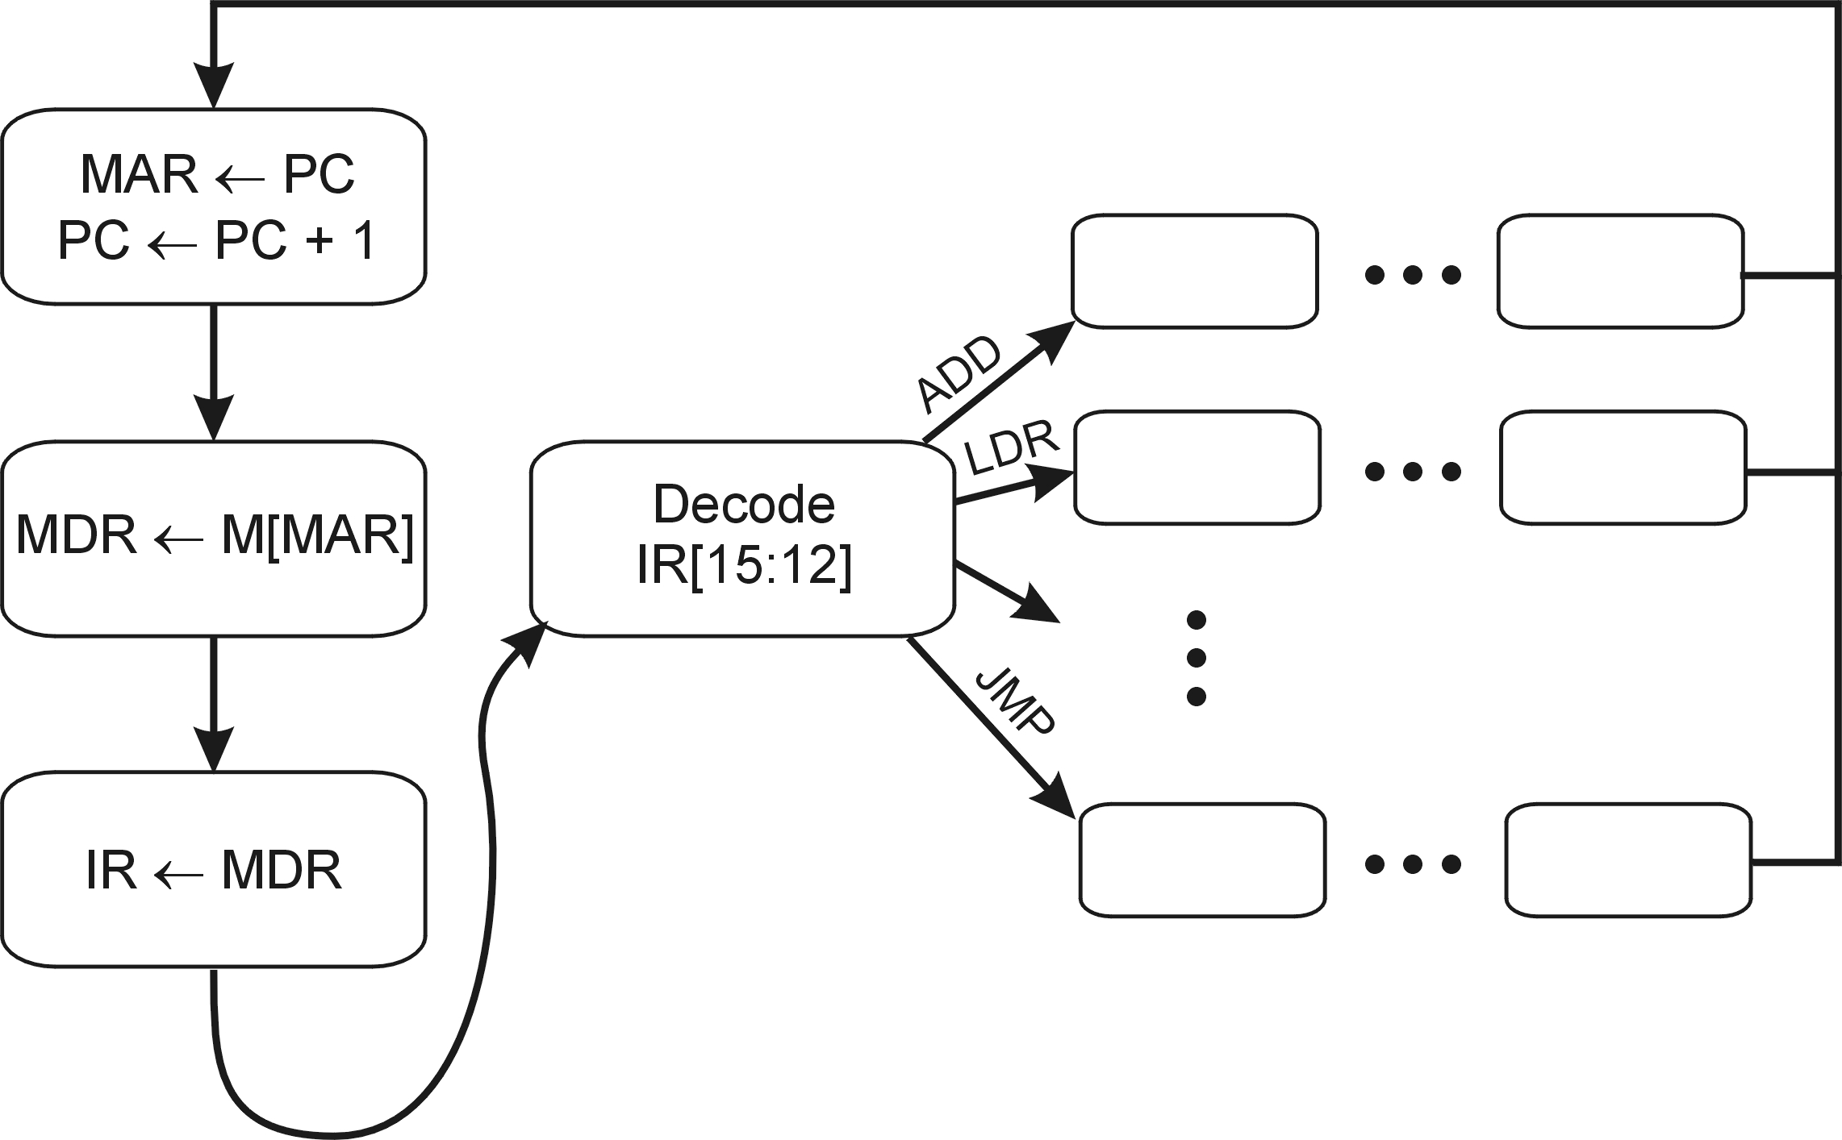
Control Unit State Diagram
The control unit is a state machine. Here is part of a
simplified state diagram for the LC-3:
A more complete state diagram is in Appendix C.
It will be more understandable after Chapter 5.

Slide 24
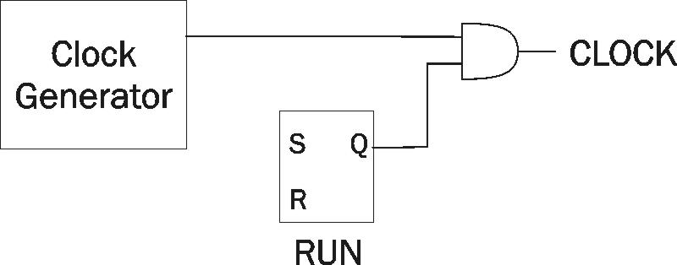
Stopping the Clock
Control unit will repeat instruction processing sequence
as long as clock is running.
  If not processing instructions from your application,
  then it is processing instructions from the Operating System (OS).
  The OS is a special program that manages processor
  and other resources.
To stop the computer:
  AND the clock generator signal with ZERO
  When control unit stops seeing the CLOCK signal, it stops processing.

